Slide 1
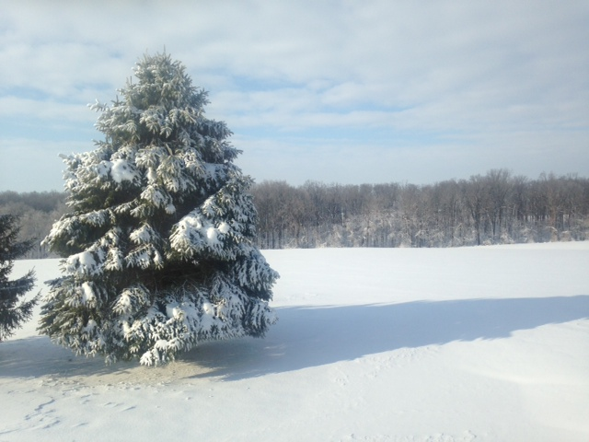
Hebrews 10.24-25

Slide 2
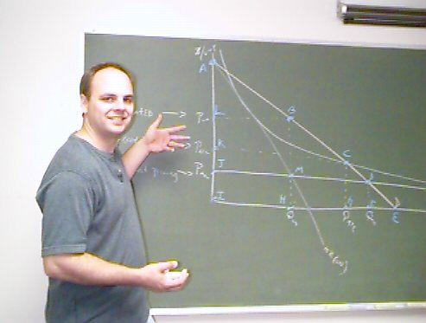

Slide 3
Context for Hebrews 10.24-25:
 Christ’s sacrifice is good forever.
 Through Christ, we have God’s grace & forgiveness.
 Through Christ, we have direct access to God.
 10.23: Let us hold fast the confession of our hope without wavering, for he who promised is faithful.

Slide 4
Hebrews 10.24-25 ESV: And let us consider how to stir up one another to love and good works, not neglecting to meet together, as is the habit of some, but encouraging one another, and all the more as you see the Day drawing near.

Slide 5
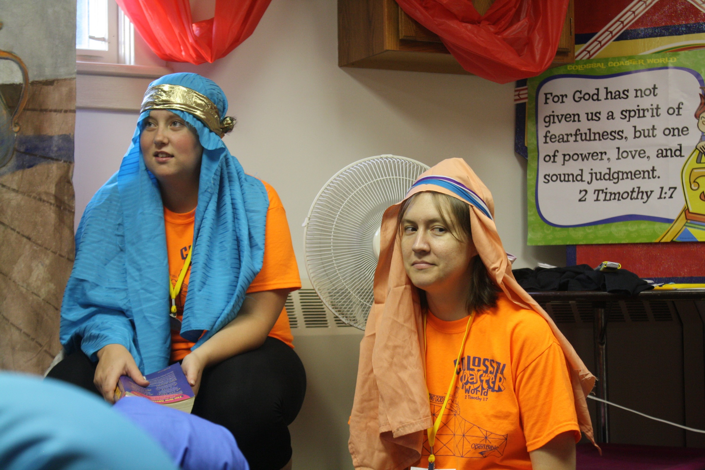
Hebrews 10.24 ESV
And let us consider how to stir up one another to love and good works…
VBS!

Slide 6
Hebrews 10.24 ESV
And let us consider how to stir up one another to love and good works…
ἀγάπη [ah-GAH-pay]
God’s kind of love:
unwavering
sacrificial
unconditional
amazing!

Slide 7
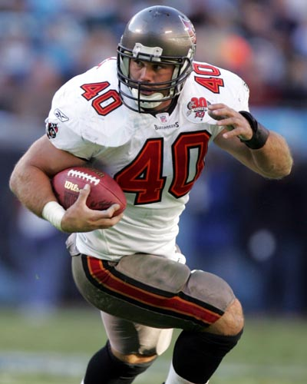
Hebrews 10.24 ESV
And let us consider how to stir up one another to love and good works…
ἀγάπη [ah-GAH-pay]
God’s kind of love:
unwavering
sacrificial
unconditional
amazing!

Slide 8
ESV: And let us consider how to stir up one another to love and good works…
NLT 1.0: Think of ways to
encourage one another to
outbursts of love and good
deeds.
image from tillhecomes.org

Slide 9
Hebrews 10.24 ESV
And let us consider how to stir up one another to love and good works…
παροξυσμός
[pah-rah-ksoos-MAHS]
a provocation
image from anythingaboutkids.com

Slide 10
Hebrews 10.24 ESV
And let us consider how to stir up one another to love and good works…
Hebrews 10.24 [interpreted]
Let us think of ways to provoke one another into amazing,
God-driven, God-revealing,
good works of sacrificial and unconditional love!
image from freepik.com

Slide 11
Hebrews 10.25 ESV
…not neglecting to meet together, as is the habit of some…
Christian fellowship...
is necessary for obedience
is necessary for health
facilitates outreach
facilitates spiritual growth

Slide 12
Hebrews 10.25 ESV
…not neglecting to meet together, as is the habit of some, but encouraging one another…
παρακαλέω [pah-rah-kah-LEH-oh]
= encourage, call to, exhort, request, comfort, be friendly to. . .

Slide 13
Hebrews 10.25 ESV
…not neglecting to meet together, as is the habit of some, but encouraging one another…
παρακαλέω [pah-rah-kah-LEH-oh]
Hebrews 13.19 ESV: I urge you…
Hebrews 13.22 ESV: I appeal to you…
[“urge” in most other translations]

Slide 14
Hebrews 10.25 ESV
…not neglecting to meet together, as is the habit of some, but encouraging one another…
παρακαλέω [pah-rah-kah-LEH-oh]
Hebrews 3.12-13 ESV: Take care, brothers, lest there be in any of you an evil, unbelieving heart, leading you to fall away from the living God. But exhort one another every day, as long as it is called “today,” that none of you may be hardened by the deceitfulness of sin.

Slide 15
Hebrews 10.25 ESV
…not neglecting to meet together, as is the habit of some, but encouraging one another…
παρακαλέω [pah-rah-kah-LEH-oh]
= encouraging one another in faith
= encouraging one another in things that draw us closer to God and warning each other about things that take us away from God

Slide 16
Hebrews 10.25 ESV
…not neglecting to meet together, as is the habit of some, but encouraging one another…
= encouraging one another in faith
includes warning each other about things that take us away from God
sin… even small sins

Slide 17
Hebrews 10.25 ESV
…not neglecting to meet together, as is the habit of some, but encouraging one another…
= encouraging one another in faith
includes warning each other about things that take us away from God.
sin… even small sins
distraction

Slide 18
People do not drift toward holiness. Apart from grace-driven effort, people do not gravitate toward godliness, prayer, obedience to scripture, faith, and delight in the Lord. We drift toward compromise and call it tolerance; we drift toward disobedience and call it freedom; we drift toward superstition and call it faith. We cherish the indiscipline of lost self-control and call it relaxation; we slouch toward prayerlessness and delude ourselves into thinking we have escaped legalism; we slide toward godlessness and convince ourselves we have been liberated.
-- D.A. Carson, For the Love of God

Slide 19
Hebrews 10.25 ESV
…not neglecting to meet together, as is the habit of some, but encouraging one another…
= encouraging one another in faith
includes warning each other about things that take us away from God.
sin… even small sins
distraction
deception

Slide 20
Hebrews 10.25 ESV
…not neglecting to meet together, as is the habit of some, but encouraging one another…
= encouraging one another in faith
includes warning each other about things that take us away from God.
sin… even small sins
distraction
deception
שׁוּב [SHOOV]
= turn back, return to God

Slide 21
Hebrews 10.25 ESV
…not neglecting to meet together, as is the habit of some, but encouraging one another…
= encouraging one another in faith
includes encouraging one another in things that draw us closer to God
learning about God
connecting to God
serving God
healing by God

Slide 22
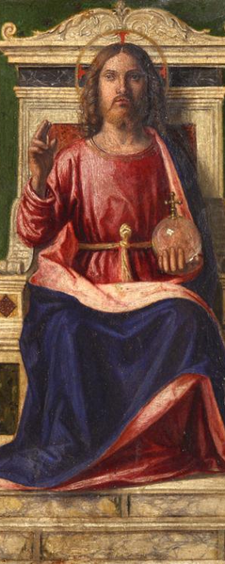
Hebrews 10.25 ESV
…not neglecting to meet together, as is the habit of some, but encouraging one another, all the more as you see the Day drawing near.
Jesus is coming back!
image by Cima da Conegliano; from italian-art.ru

Slide 23
Action Steps
1. Form strong friendships with other believers and spend time with them.
2. Encourage each other in faith and hold each other accountable, to stay in a healthy relationship with God.
3. Think of ways to provoke each other into amazing acts of love, and do them together.

